Slide 1

Antenatal Care
Dr. SHEEBA. S.,
ASSISTANT PROFESSOR,
DEPT OF OBG

Slide 2
DEFINITION
Comprehensive health supervision of a pregnant woman before delivery.
Or
It is planned examination, observation and guidance given to the pregnant woman from conception till the time of labor.

Slide 3
GOALS
To reduce maternal and perinatal mortality and morbidity rates
To improve the physical and mental health of women and children

Slide 4
IMPORTANCE OF ANTENATAL CARE
To ensure that the pregnant woman and her fetus are in the best possible health.
To detect early and treat properly complications
Offering education for parenthood
To prepare the woman for labor, lactation and care of her infant

Slide 5
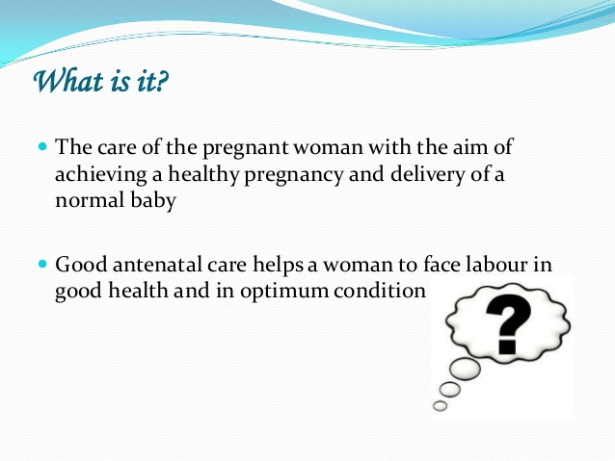

Slide 6

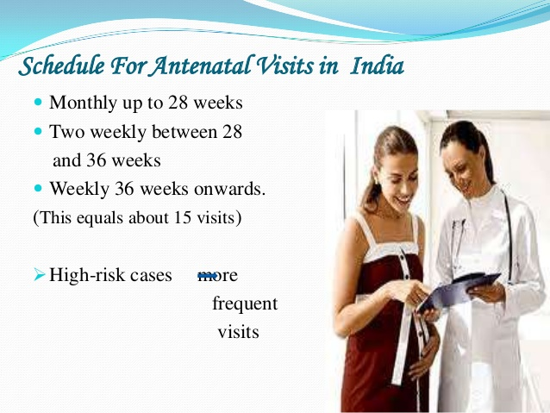
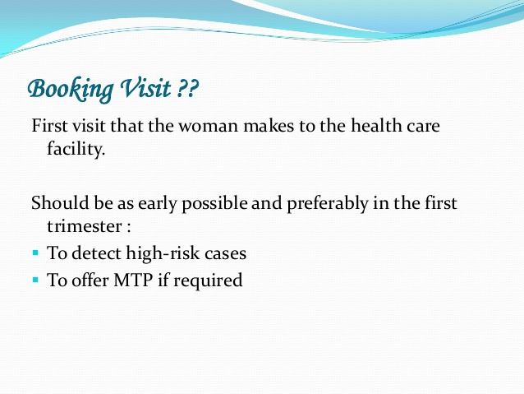
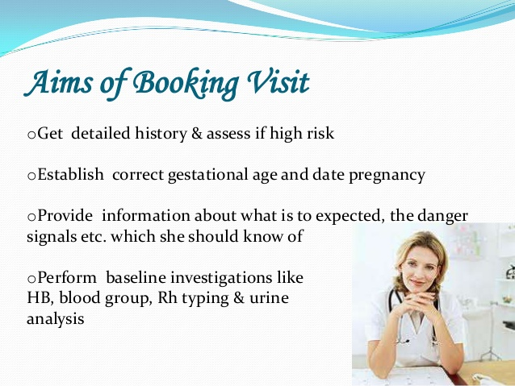
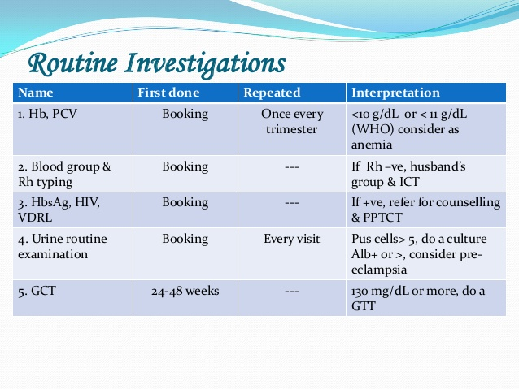
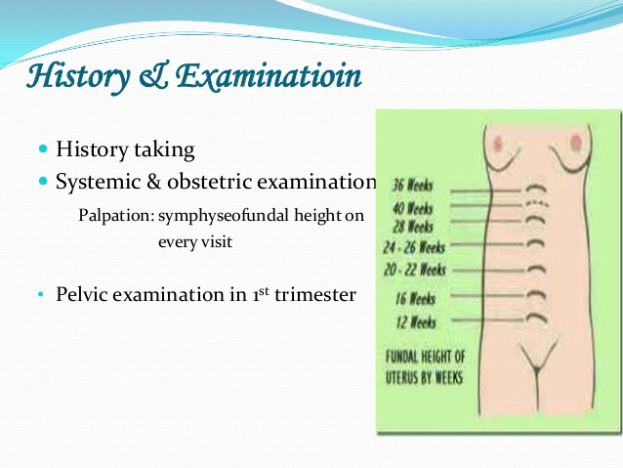
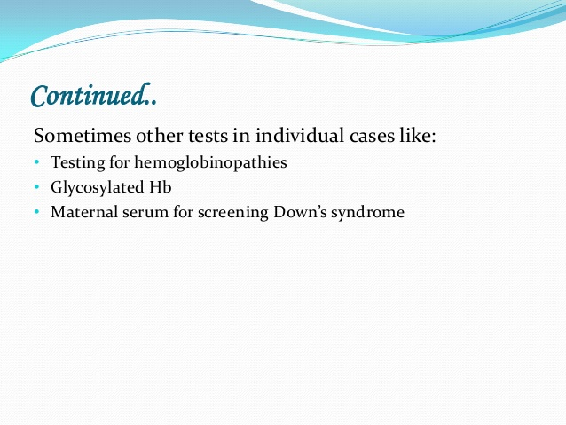
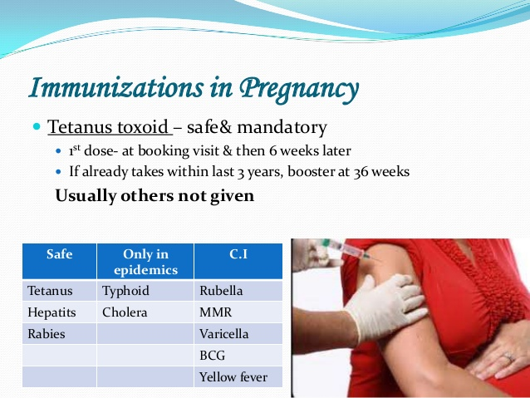
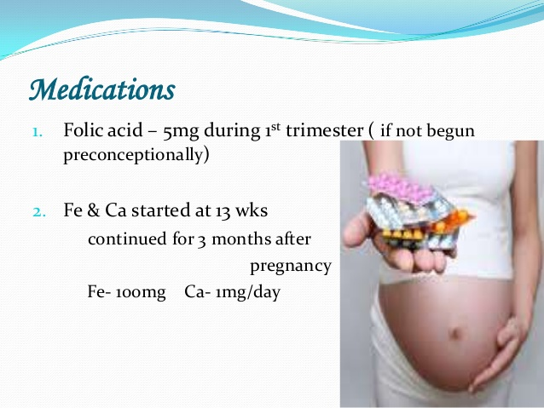

Slide 13
SCHEDULE FOR ANTENATAL VISITS:
The first visit or initial visit should be made as early is pregnancy as possible.
RETURN VISITS:
    Once every month till 28 w.
    Once every 2 weeks till the 36 w
    Once every week, till labor.

Slide 14
FREQUENCY OF ANTENATAL APPOINTMENTS
1) Nulliparous with an uncomplicated pregnancy, a schedule of 10appointments.
2) Parous with an uncomplicated pregnancy, a schedule of 7 appointments.

Slide 15
Assessment
History
Examination
Investigation

Slide 16
GESTATIONAL AGE ASSESSMENT
New Pregnant women should be offered an early ultrasound scan between 10 weeks 0 days and 13 weeks 6 days to determine gestational age and to detect multiple pregnancies.

Slide 17
New Crown–rump length measurement should be used to determine gestational age. If the crown–rump length is above 84 mm, the gestational age should be estimated using head circumference.

Slide 18
FETAL KICK COUNT
  The pregnant woman reports at least 10 movements in 12 hours.
  Absence of fetal movements precedes intrauterine fetal death by 48 hours.

Slide 19
PHYSICAL EXAMINATIONS
The approximate weight gain during pregnancy is 12 kg.; 2kg in the first 20 weeks and 10 kg in the remaining 20 weeks (1.5 kg per week until term).

Slide 20
Symphysis–fundal height should be measured and recorded at each antenatal appointment
from 24 weeks.
Fetal presentation should be assessed by
abdominal palpation at 36 weeks.

Slide 21
Fetal heart sound is heard by sonicaid as early
as 10thweek of pregnancy.
Fetal heart sound is heard by Pinard' s fetal stethoscope after the 20thweek of pregnancy

Slide 22
BREECH PRESENTATION AT TERM
External cephalic version.
If is not possible to schedule at 37 weeks then
PREGNANCY AFTER 41 WEEKS
Prior to formal induction of labour, women should be offered a vaginal examination for membrane sweeping 42 weeks

Slide 23
Health Teaching during the First Trimester
Physiological changes during pregnancy
Weight gain
Fresh air and sunshine
Rest and sleep
Diet
Daily activities
Exercises and relaxation
Hygiene
Teeth
Bladder and bowel
Sexual counseling
Smoking :
Medications
Infection
Irradiation
Occupational and environmental hazards
Travel
Follow up
Minor discomforts
Signs of Potential Complications

Slide 26


Slide 27
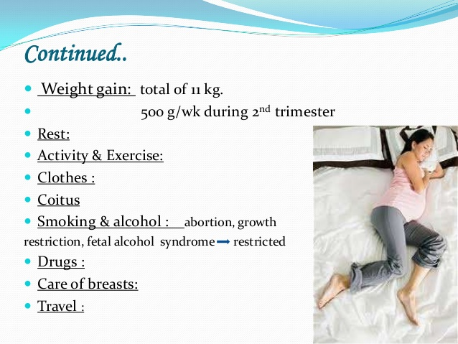

Slide 28
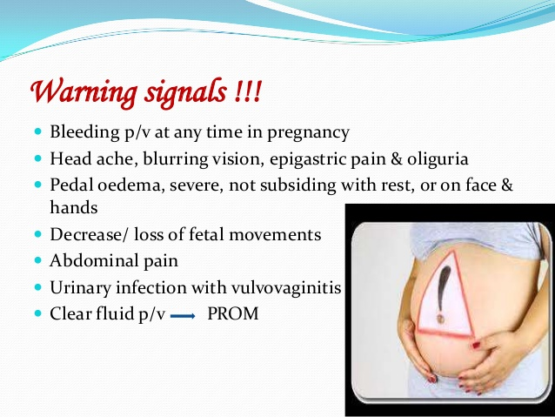

Slide 29
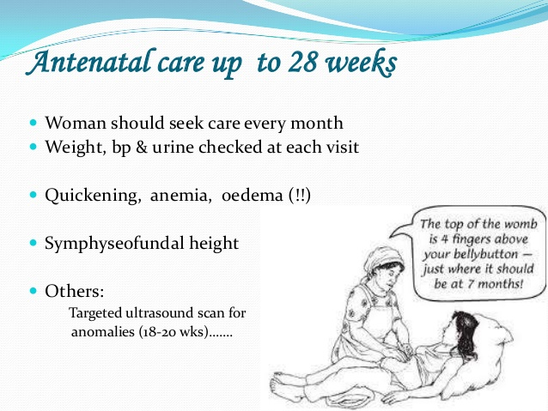

Slide 30
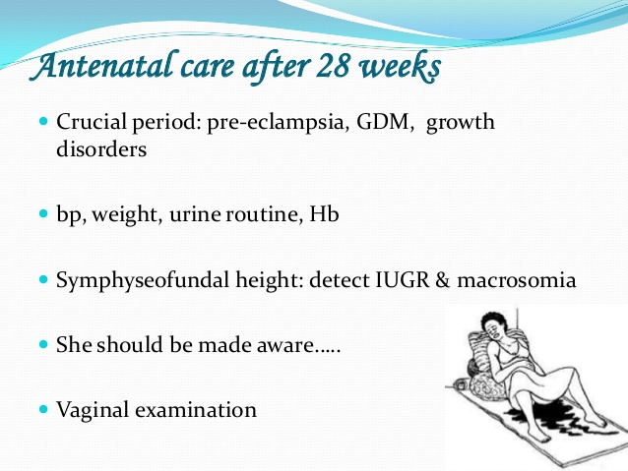

Slide 31
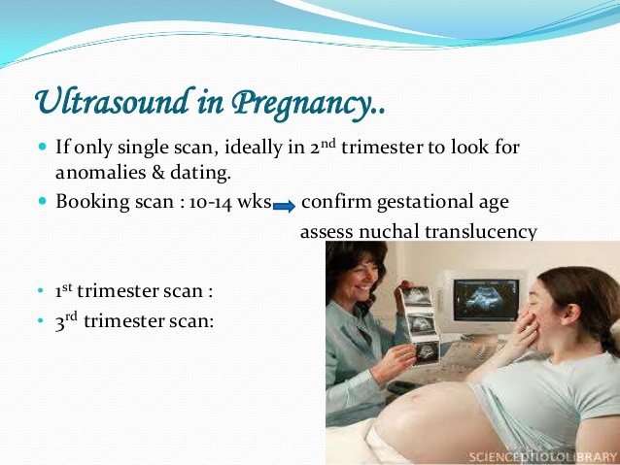

Slide 32


Slide 33
COMMON DISCOMFORTS OF PREGNANCY ANDRELIEF MEASURES :
URINARY FREQUENCY
RELIEF MEASURES:
    Decrease fluid intake at night.
    Maintain fluid intake during day.
    Void when feel the urge.

Slide 34
  FATIGUE
  RELIEF MEASURES:
    Rest frequency.
    Go to bed earlier.
  SLEEP DIFFICULTIES
  RELIEF MEASURES:
    Rest frequency
    Decrease fluid intake at night

Slide 35
  NASAL STUFFINESS AND EPISTAXIS
  ETIOLGY: Elevated estrogen levels
  RELIEF MEASURES :
    Avoid decongestants.
    Use humidifiers, and normal saline drops.

Slide 36
  PTYALISM (EXCESSIVE SALIVATION)
  ETIOLGY: Unknown
  RELIEF MEASURES:
    Perform frequent mouth care.
    Chew gum.
    Decrease fluid intake at night.
    Maintain fluid intake during day.

Slide 37
  NAUSEA AND VOMITING
  RELIEF MEASURES:
    Avoid food or smells that exacerbate condition.
    Eat dry crackers or toast before rising in morning.
    Eat small, frequent meals.
    Avoid sudden movements. Get out of bed slowly
    Breath fresh air to help relieve nausea.

Slide 38
  HEARTBURN
  RELIEF MEASURES:
    Eat small, more frequent meals.
    Use antacids.
    Avoid overeating and spicy foods.

Slide 39
    DEPENDENT EDEMA
    Avoid standing for long periods.
    Elevate legs when laying or sitting.
    Avoid tight stockings.

Slide 40
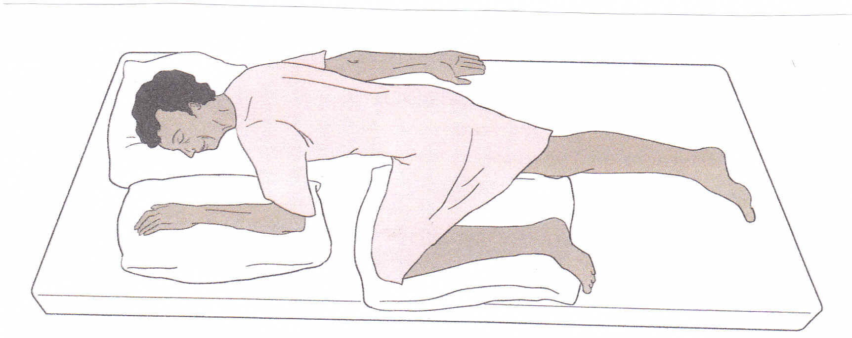
    VARICOSITIES
    Rest in sims' position.
    Elevate legs regularly.
    Avoid crossing legs.
    Avoid long periods of standing

Slide 41
  HEMORRHOIDS
  RELIEF MEASURES:
    Maintain regular bowel habits.
    Use prescribed stool softeners.
    Apply topical or anesthetic ointments to area.

Slide 42
  CONSTIPATION
  RELIEF MEASURES:
    Maintain regular bowel habits.
    Increase fiber in diet.
    Increase fluids.
    Find iron preparation that is least constipating

Slide 43
  BACKACHE
  RELIEF MEASURES:
    Wear shoes with low heels.
    Walk with pelvis tilted forward.
    Use firmer mattress.
    Perform pelvic rocking or tilting

Slide 44
  LEG CRAMPS
  RELIEF MEASURES:
    Extend affected leg and dorsiflex the foot.
    Elevate lower legs frequently.
    Apply heat to muscles.

Slide 45
ANAEMIA
Pregnant women should be offered screening for anemia
Screening should take place early in pregnancy (at the booking appointment) and
At 28 weeks when other blood screening tests are being performed. This allows enough time for treatment if anemia is detected.

Slide 46
BLOOD GROUPING AND RH FACTOR
Women should be offered testing for blood group and rhesus D status in early pregnancy.
It is recommended that routine antenatal anti-D prophylaxis is offered to all non-sensitised pregnant women who are rhesus D-negative.

Slide 47
BOOKING APPOINTMENT (IDEALLY BY 10 WEEKS)
At the booking appointment, give the following information (supported by written information and antenatal classes), with an opportunity to discuss issues and ask questions…..

Slide 48
CRITERIA BASIS
• Nutrition and diet, including vitamin D supplementation
• Exercise, including pelvic floor exercises
• Antenatal screening, including risks and benefits of the screening tests
• Place of birth
• Breastfeeding, including workshops

Slide 49

AT THIS APPOINTMENT
• Identify women who may need additional care and plan pattern of care for the pregnancy
• Check blood group and rhesus D status
Anemia,
Hepatitis B virus,
HIV, rubella susceptibility and
Syphilis

Slide 50
Offer screening for asymptomatic bacteriuria
• Offering screening for Down’s syndrome
• Offer early ultrasound scan for gestational age assessment
• Offer ultrasound screening for structural anomalies
• Measure height, weight and calculate body mass index

Slide 51
Measure blood pressure and test urine for proteinuria
• Offer screening for gestational diabetes and pre-eclampsia using risk factors
• Ask about any past or present severe mental illness or psychiatric treatment
• Ask about possible depressions
• Ask about the woman’s occupation to identify potential risks.

Slide 52
GESTATIONAL DIABETES SCREENING SHOULD BE BASED ON RISK FACTORS.
THEY INCLUDE:
BMI > 30 kgm/m²,
Previous macrosomic baby (one weighing >4.5 kgms),
Family history of diabetes,
History of gestational diabetes, or
Higher risk family origin ( S Asian, black Caribbean, Middle Eastern).
Where indicated screening should be done using a glucose tolerance test at, or soon after, the booking appointment.

Slide 53
At the booking appointment, for women who choose to have screening, the following tests should be arranged:
• Blood tests (for checking blood group and rhesus D status and screening for, anaemia,, hepatitis B
Virus, HIV, rubella susceptibility and syphilis), ideally before 10 weeks
Urine tests (to check for proteinuria and screen for asymptomatic bacteriuria)
Ultrasound scan to determine gestational age using

Slide 54
SCREENING

Slide 55
SCREENING FOR FETAL ANOMALIES
New The 'combined test' (nuchal translucency, beta-human chorionic gonadotrophin, pregnancy-associated plasma protein-A) should be offered to screen for Down's syndrome between 11 weeks 0 days and 13 weeks 6 days.

Slide 56
For women who book later in pregnancy the most clinically and cost-effective serum screening test (triple or quadruple test) should be offere.

Slide 57
SCREENING FOR GESTATIONAL DIABETES
New risk factors for gestational diabetes :
Body mass index above 30 kg/m²
Previous macrosomic baby weighing 4.5 kg or above
Previous gestational diabetes (refer to 'Diabetes in pregnancy
Family history of diabetes (first-degree relative with diabetes)
Family origin with a high prevalence of diabetes.

Slide 58
SCREENING FOR HAEMATOLOGICAL CONDITIONS
New Screening for sickle cell diseases and thalassaemias should be offered to all women as early as possible in pregnancy (ideally by 10 weeks).

Slide 59
Are women receiving antenatal care from a health care provider?
Percent

Slide 60
Source of Antenatal Care
Percent

Slide 61
51 percent of women received NO antenatal care

Slide 62
Number of Antenatal Care Visits
Percent

Slide 63
How many months pregnant are women at their first ANC visit?
Percent

Slide 64
How many months pregnant are women at their first ANC visit?
Median number of months at 1st visit
Urban areas: 4.0
Rural areas: 5.1

Slide 65
Quality of Antenatal Care
Percent

Slide 66
Does tetanus toxoid coverage vary by zone and region?
Percent of women receiving
two or more
tetanus toxoid injections

Slide 67
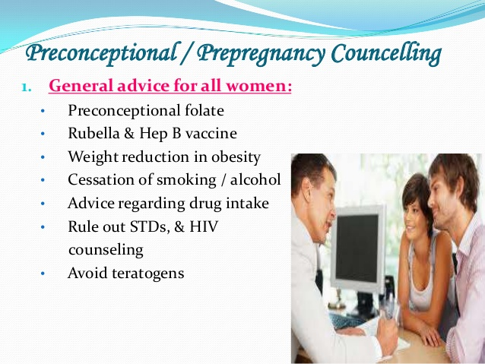

Slide 68
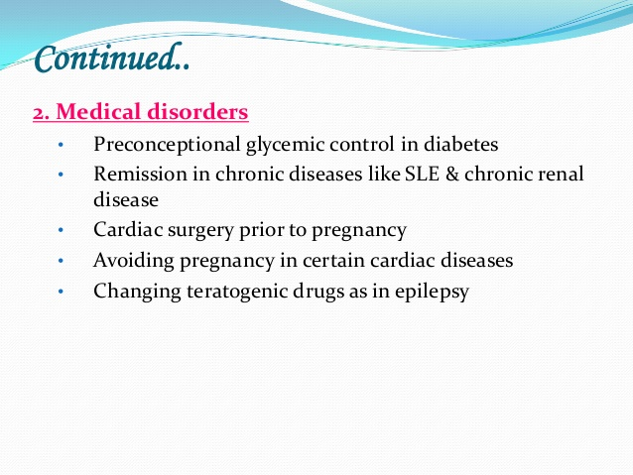

Slide 69
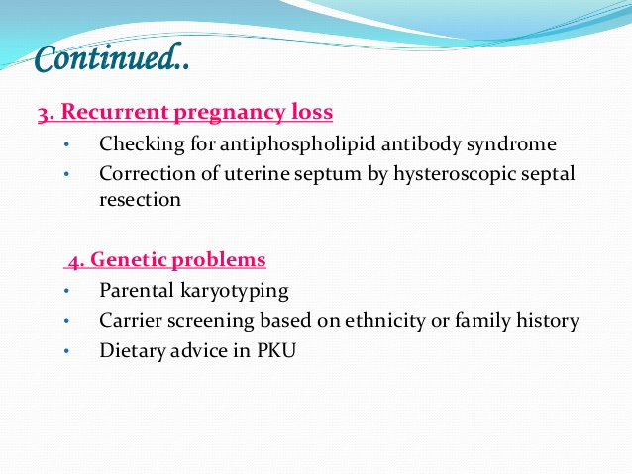

Slide 70
Points to be remembered……
Early registration of pregnancies (12 – 16 weeks)
Minimum 3 antenatal visits (20,32,36 weeks) check-ups
Anaemia prophylaxis ( Iron and Folic acid tablets)
Two doses of TT
Minimum investigations( Weight, B.P,Blood group, Rh typing, Urine examination,VDRL,HIV (TRIDOT TEST)

Slide 71
Points to be remembered……..
Identification of high risk group, Early detection of complication of pregnancy & timely , safe.
Health education on diet, breast feeding, care of breast, personnel hygiene during pregnancy,& family planning

Slide 72

CONCLUSION
Antenatal care is very essential for bringing up healthier generations. Only healthy mother can produce a healthy offspring.

Slide 73

Thank you……

